Slide 1
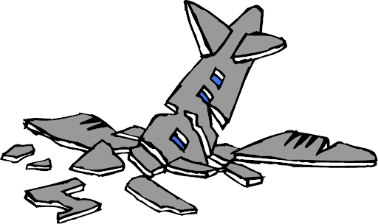
PowerPoint: Biggest Design Mistakes
Dr. John A. Gedeon
June 2021

Slide 2
Training Objectives
The reader will be able to:
Avoid common technical slide design errors
Design slides to reduce the occurrence of presentation problems

Slide 3
Slide Format in this PowerPoint
The slide TITLE refers to the problem area
In the BODY, the bold sentence states the problem
The bulleted points under it suggests the correct ways to handle that issue or best practices

Slide 4
No Presentation Objectives
Objectives for the presentation/training are not stated
The session title is not enough for the participants to know about its content or it they are fully interested in it
Some authors use topics which is an area of discussion but does not specify what the participants will learn about, like objectives
Everything in the PowerPoint presentation should support the objectives--if not leave it out (or have a slide at the end for additional resources)

Slide 5
Rules of Engagement
Confusion on how the presentation will proceed
Let participants know if they can interrupt you for a question or have to wait until you are done
Tell them about the handouts or recordings you will provide
When are breaks and other housekeeping matters
Provide technical instructions in using platform features or break-out rooms

Slide 6
Slides vs. Presenter Conflict
Participants read the slides instead of listening to the presenter
The slide is road map to show where you are at in the presentation, the narration of the story is the most important part
Too much text encourages reading for both the participants and the presenter

Slide 7
Format Consistency
Constantly changing formats and styles
Use the same backgrounds, fonts, sizes, and colors where possible, changing these without a compelling reason confuses the viewer
It is like going into a new supermarket and you have to search for everything, as it is not formatted like your normal supermarket

Slide 8
Poor Templates
Template is distracting
People will pay attention to the distraction instead of the content
Use a clean template with few colors

Slide 9
Repeated Slide Titles
Using the same title for a number of slides!
Every PowerPoint slide must have a unique title that reflects its content
Titles serve the same purpose as the “Subject” line on an email (you get an idea of the contents)

Slide 10
Descriptive Slide Titles
Too many slides have generic or vague titles
Titles should be descriptive, not generic. The “10 Principles”(…of what?)
The “Six-Step Method” for what?
“Problems” what kind of problems?

Slide 11
Bullets vs. Numbering
Making no distinction between bullets and numbering points
Use bullets when there is no particular order to the list
Use numbers when there is a sequence, like the 5-Step method
Also use numbers if the list is long so people can refer to a particular point quickly (not the third bullet from the bottom)

Slide 12
Bulleting One Point
Using bulleting when only one point is presented
If you have only one point, do not use a bullet, it is used to separate multiple points

Slide 13
Too much Text
Slide crowed with a lot of text
It is PowerPoint, not power-paragraph or power-book
Only use full sentences for important quotations or excerpts (or if it is a read-only PowerPoint—no presenter)
With too much text, they will be reading it instead of listening to you

Slide 14
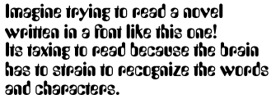
Text Typeface for Online Displays
Typeface is either hard to read or illegible (not clear)
Use a clean typeface not crowed together (see example…)
Never use all CAPS, as it is the equivalent of shouting

Slide 15
Text Justification
Text is center or right justified
The eyes follow left justification easier
Try reading the text to the right…

Slide 16
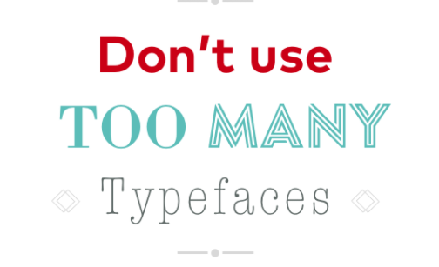
Too many Typefaces
Constantly changing typeface styles
As the example shows, it is too confusing
Your first typeface sets a mental expectation for those that follow

Slide 17
Text Size
Fonts too small to be read online, in a room, or printed on paper
To avoid that problem in all those environments, keep minimum font size at 24
If you don’t have enough room on one slide, spill over on to another slide or shorten the points

Slide 18
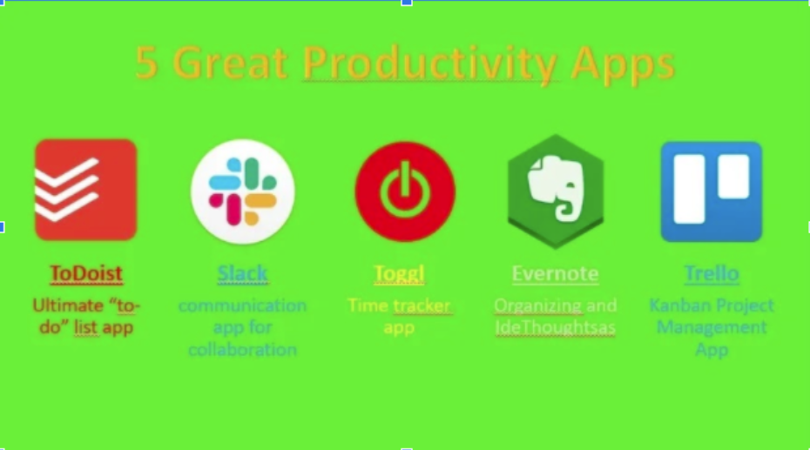
Poor Contrast
Text is hard to read due to poor contrast of colors or typeface
Font color not contrasting with background
Includes background images that interferes with overlaid text

Slide 19
All Text no Multimedia
Text-a-holics forget about multimedia
The Power in PowerPoint is going beyond text to use images, diagrams, graphs, videos, audio, animations, etc. to present the information
Figure out how the best and most interesting way to represent your ideas
All text is also boring (and be done in a Word document)

Slide 20
Conflict between Text & Visuals
Visuals/audio do not match text/voice
The animated figure is a man but with a woman’s voice
See the visual example…

Slide 21
Overcrowding the Slide
Slide is too “busy”
This causes confusion as you do not know what is important or what to focus on
Every item must reinforce the core message: design—don’t decorate

Slide 22
Alignment of Objects
Text and images just stuck in anywhere
Like the previous slide, there is no alignment or flow, as you mind has to spend time figuring out what is going on
Your slide should communicate instantly
For more help click HERE

Slide 23
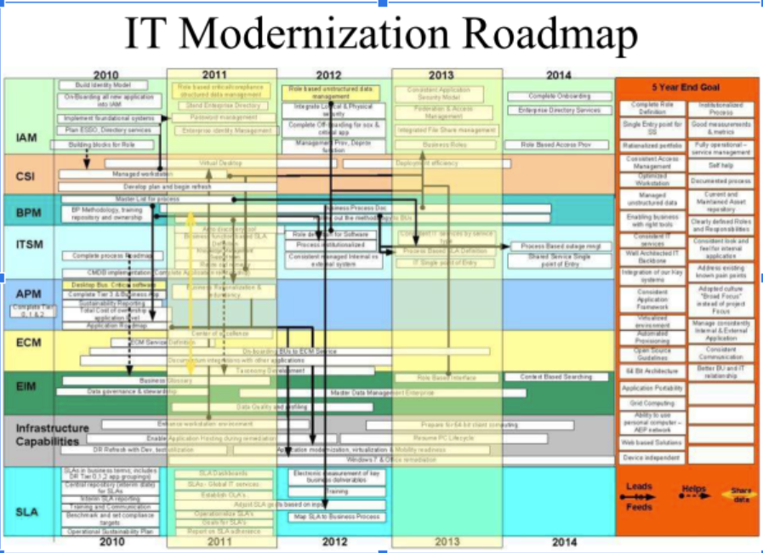
Detailed Diagrams
Too many boxes and arrows
It would take an hour to describe this diagram
Use a summarized or high-level diagram
Present sub-diagrams on other slides
Use handouts for detailed diagrams

Slide 24
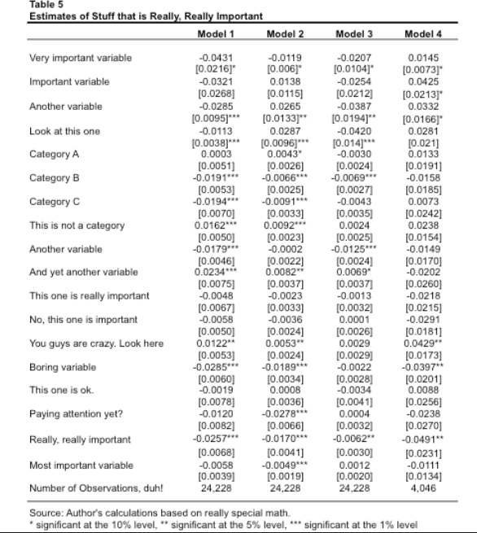
Too much data
Too much detail in data
Summarize the data
Use graphs or charts to make sense of it
Put detailed data in handouts

Slide 25
Poor Quality Images
Image with jagged edges or out of focus
Sharp, clear images communicate best
Show just the areas that support your objective

Slide 26
Not cropping/trimming images
Image has non essential detail
Crop the image for your area of focus
Press “SHIFT + S + Windows key” then use your mouse to crop on screen and paste result

Slide 27
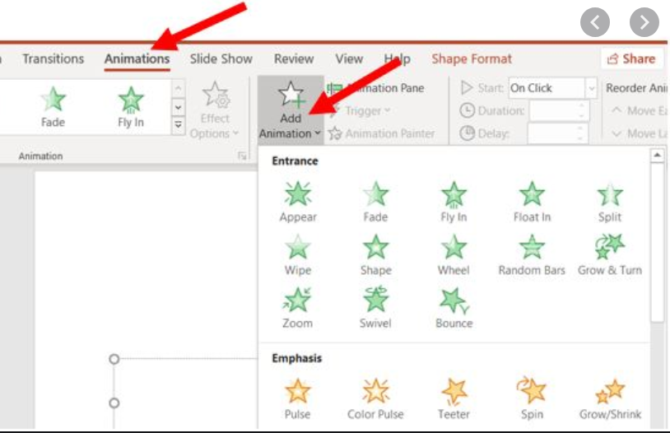
Use of Distracting Features (Bells & Whistles)
Using noisy or flashy transitions between slides or objects in a slide
People pay more attention to that than the content
It may be cute, but gets ‘tired’ very quickly

Slide 28
Constantly Moving Visuals
GIF’s (Graphics Interchange Format) images draw attention away from the text or presenter
Do not use them unless they are demonstrating a point
Use static visuals that relate to the content

Slide 29
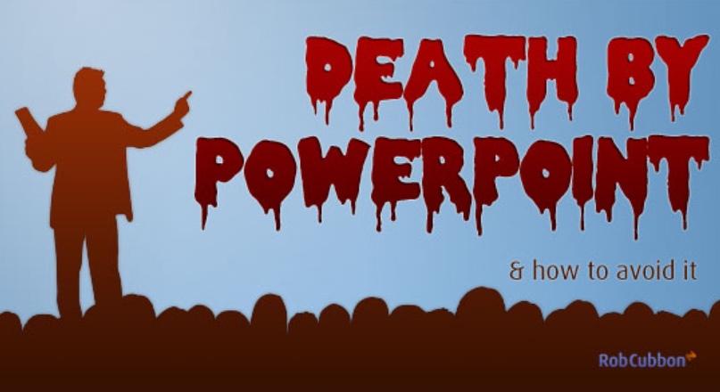
Number of Slides
Most use too many slides in a presentation
Figure roughly on 2 minutes per slide
Better yet, rehearse the slides to determine duration
Build in time for questions/discussion
When running out of time, you will then be tempted to start to flash slides quickly before they can be fully understood (bad)

Slide 30
Reading the Slide
You read slides word-for-word
It happens because you have the text in a readable form (sentences)
This is the quickest way to bore people

Slide 31
Showing all the slide content at once
All points are visible as the slide appears
They will be reading your whole list while you are still talking about point #1
Use “Appear” with each mouse click, or
Use the “Dim Text” feature (HERE)
The same for a model/diagram, show each piece sequentially and tell a story

Slide 32
Switching between external content
Content opens in another program
This can be a distraction as you switch back and forth from your presentation
Arrange for external content to be embedded in your presentation
Use just enough to make your point
Try it: click on the video…
For more help click: HERE

Slide 33
Cute Endings
Ending the presentation with a sunset, a cute animal, or a group photo
It is just not professional
Your parting slide could be an inspirational quote or a summary of important points or the core model (for Q & A)

Slide 34
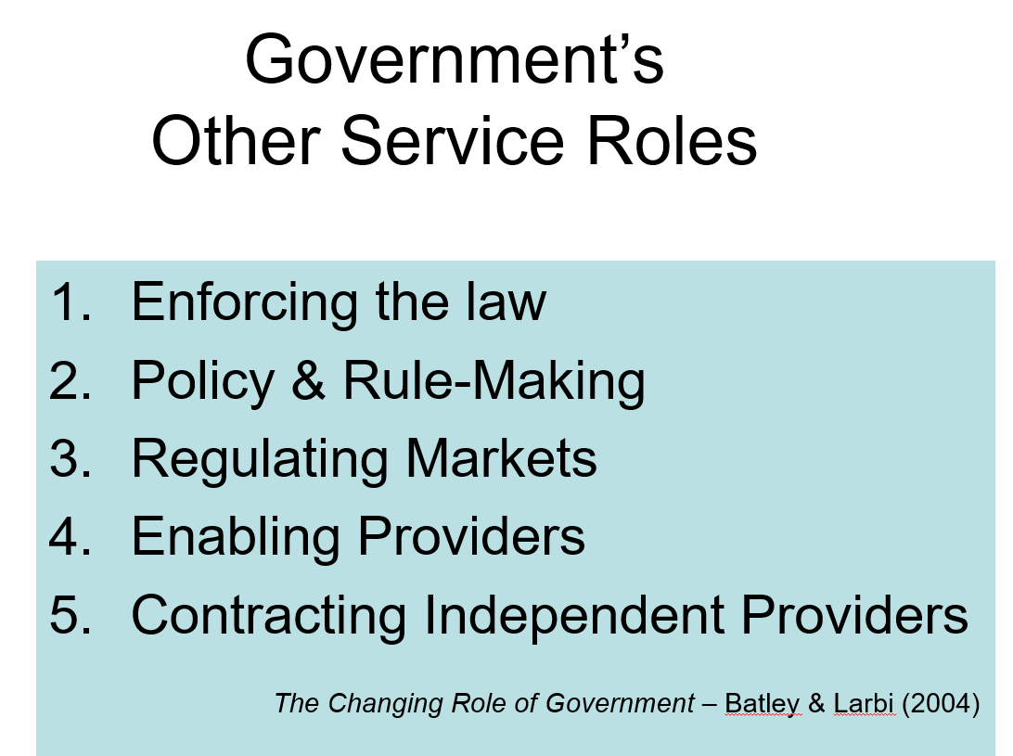
Not Crediting Sources
Sources not cited or credited
If you are using other’s specialized information you need to identify and credit the source
You can either do that at the bottom of a slide (academic) or put all sources in the final slide
Embed the web link so readers can check them out

Slide 35
References
Peregrine Communications - https://www.peregrinecommunications.com/insights/common-mistakes-powerpoint-presentations
Koalaty Studio - https://www.koalaty.studio/post/10-most-common-presentation-design-mistakes
Studiokayama - https://studiokayama.com/wp-content/uploads/2013/04/10DesignMistakes1.2.pdf

Slide 36
About the Author
Dr. John A. Gedeon
Management & Educational Consultant & Trainer
Doctorate in Educational Technology & Distance Education
Contact: john.gedeon@gmail.com
Website: www.johngedeon.com

